Slide 1
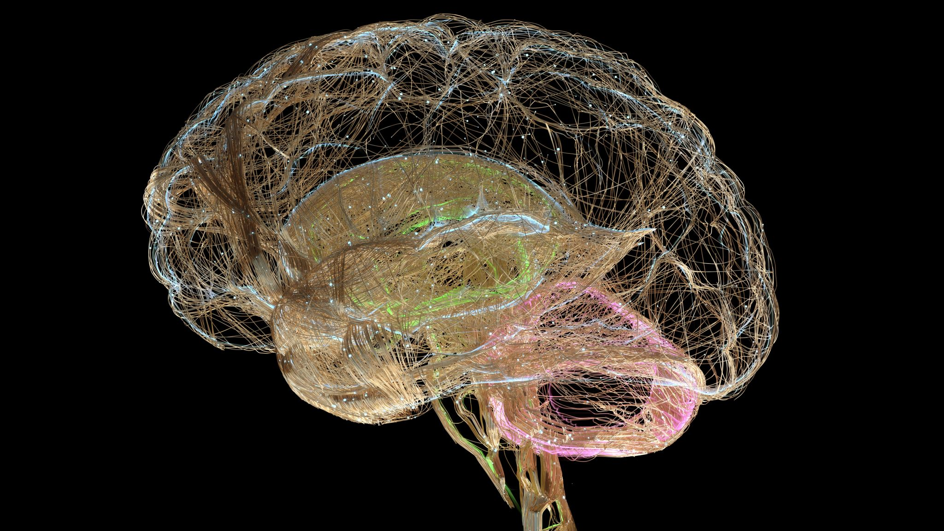
Title: Image Classification of Brain Tumor Through MRI Images
Subtitle: A Data-Driven Approach Using Machine Learning
Presented by: Barath Nochipalayam Subramaniam
Date: 14-10-2024

Slide 2
Introduction
What is Image Classification?
Image classification is a process in machine learning where an algorithm is trained to assign labels to images. In this case, we classify MRI images of brain tumors to distinguish between different types of tumors.
Importance of Brain Tumor Classification
Detecting and classifying brain tumors early improves treatment outcomes.
MRI scans are a key tool in diagnosing and tracking brain tumors, making automated classification an important step in aiding medical professionals.

Slide 3
Aim:
To classify brain tumor MRI images using a machine learning model, specifically a Convolutional Neural Network (CNN), to improve diagnostic accuracy.
Objectives:
Preprocess the MRI image data for training the model.
Train a CNN model to classify tumor types.
Evaluate the model’s performance using accuracy, precision, and recall.
Explore possible improvements and future work.
Project Aim and
Objectives

Slide 4
Dataset Overview
Source:
Dataset from Kaggle (https://www.kaggle.com/datasets/rishiksaisanthosh/brain-tumour-classification).
Description:
The dataset contains MRI images categorized into three types of brain tumors: Glioma, Meningioma, and Pituitary tumors.
Total number of images add in the data sets
Challenges:
Variability in MRI images due to different machines and settings.
The dataset might include noise or artifacts that need to be cleaned.

Slide 5
Data Preprocessing
Steps:
Image Augmentation: Rotating, flipping, and scaling images to increase data variability.
Normalization: Ensuring pixel values are on a consistent scale.
Resizing Images: All images resized to [specific dimensions] to ensure uniformity.
Splitting the Data: Dividing into training, validation, and testing sets to avoid overfitting.
Tools Used:
Python libraries such as OpenCV and TensorFlow/Keras were used to preprocess the images and ensure they are suitable for the CNN model.

Slide 6
Model Architecture - CNN
Convolutional Neural Networks (CNN):
CNN is a deep learning algorithm that takes an input image, assigns importance (learnable weights and biases) to various aspects/objects in the image, and differentiates one from the other.
CNN Layers Used:
Input Layer: Takes in the MRI images.
Convolutional Layers: Detects features in the images such as edges, shapes, and textures.
Pooling Layers: Reduces the dimensionality of the data while retaining important information.
Fully Connected Layers: Final layers that classify the image based on features extracted.
Output Layer: Uses Softmax activation to classify the image into one of the tumor types.

Slide 7
Model Evaluation and Results
Metrics for Evaluation:
Accuracy: The proportion of correctly classified images out of the total.
Precision & Recall: Measure the model's ability to correctly identify true positives and false negatives.
F1 Score: The harmonic mean of precision and recall, giving a balanced view of model performance.
Confusion Matrix:
Visual representation showing how many images were classified correctly or incorrectly for each tumor type.
Results:
The CNN achieved an accuracy of [insert percentage], with room for improvement in some categories.

Slide 8
conclusion
This project successfully implemented a Convolutional Neural Network (CNN) to classify MRI images of brain tumors into distinct categories, demonstrating the potential for deep learning models to assist in medical diagnostics. The model's accuracy, while promising, highlights the importance of machine learning in automating complex medical tasks and supporting healthcare professionals by providing reliable classification results from MRI data. By leveraging CNNs, this approach offers a valuable contribution to the ongoing development of medical imaging technologies.

